Slide 1
Fundamentals of Machine Learning
Prepared by
Prince Thomas M.E., PhD
Associate Professor

Slide 2
Chapter 4: Unsupervised Learning and Graphical Models
Clustering Methods
K-Means Clustering: Centroid Calculation and Convergence
Hierarchical Clustering: Agglomerative and Divisive Methods
Frequent Pattern Mining
Apriori Algorithm and Association Rules
Applications in Market Basket Analysis
Graphical Models
Bayesian Networks
Markov Networks
Hidden Markov Models (HMMs)
States, Transitions, and Observations
Forward Algorithm and Viterbi Algorithm
Applications in Speech Recognition and NLP

Slide 3
Unsupervised learning
It involves analyzing and clustering data without labeled outputs.
It tries to find hidden patterns, structures, or features within the data.
It is primarily used for exploratory data analysis and tasks where the goal is to uncover insights rather than predict labels.
Key Characteristics
No labeled data is provided; only input data is available.
Focuses on understanding data distributions, relationships, and patterns.
Examples include clustering, dimensionality reduction, and anomaly detection.
Major Technique
Clustering
Dimensionality Reduction
Association Rule Mining

Slide 4
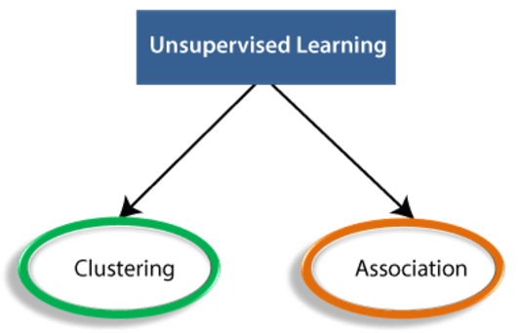
Types of Unsupervised Learning Algorithm
The unsupervised learning algorithm can be further categorized into two types of problems:

Slide 5
Clustering
It is an unsupervised learning technique.
It used to group data points into clusters based on their similarity.
Data points in the same cluster are more similar to each other than to those in other clusters.
Clustering is widely used for exploratory data analysis and pattern recognition.
Clustering Methods
K-Means Clustering
Hierarchical Clustering
DBSCAN (Density-Based Spatial Clustering of Applications with Noise)
Mean-Shift Clustering
Gaussian Mixture Models (GMM)
Applications of Clustering
Customer segmentation
Social network analysis
Market segmentation

Slide 6
K-Means Clustering
K-Means Clustering is a popular unsupervised machine learning algorithm.
It is used to partition a dataset into distinct clusters.
Each cluster is represented by a centroid, and the algorithm iteratively assigns data points to clusters and updates these centroids until convergence.
Steps of Algorithm
Select random K points or centroids.
Assign each data point to their closest centroid, which will form the predefined K clusters.
Calculate the variance and place a new centroid of each cluster.
Repeat the third steps, which means reassign each datapoint to the new closest centroid of each cluster.
If any reassignment occurs, then go to step-4 else go to FINISH.
The model is ready.

Slide 7
Centroid in K-Means Clustering
The centroid is the central point of a cluster in K-Means Clustering.
It is a representative "average" position for all the data points in a cluster.
The algorithm uses centroids to determine which data points belong to which cluster and updates their positions iteratively for better clustering.
Definition
A centroid is the geometric center of a cluster, calculated as the mean of all data points within the cluster.
Convergence in K-Means occurs when the algorithm stops updating centroids or cluster assignments. This happens when the clusters stabilize, meaning the centroids no longer change significantly
Manhattan and Euclidean distance are used to find the distance between the two data point.

Slide 8
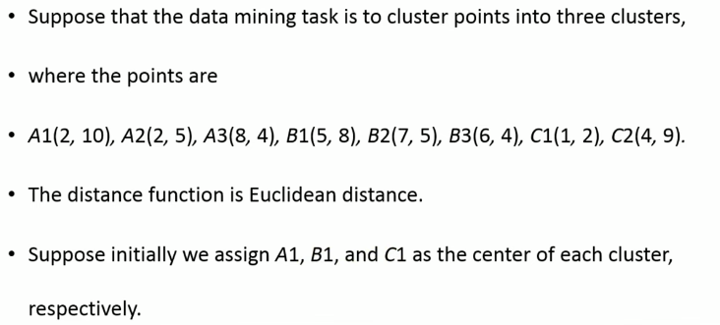
Example:

Slide 9
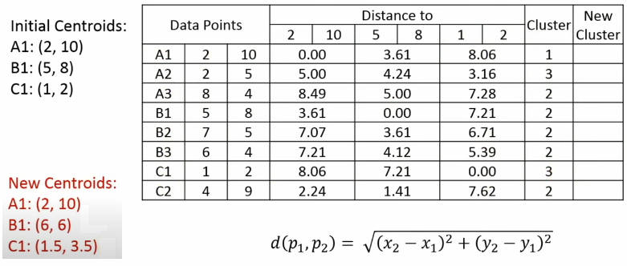

Slide 10
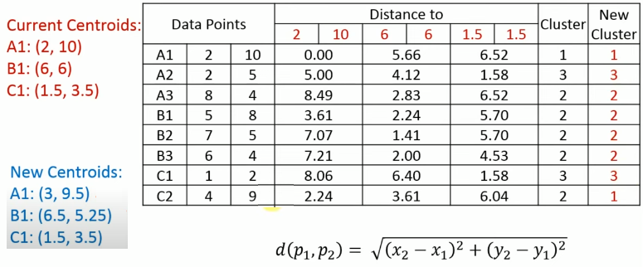

Slide 11
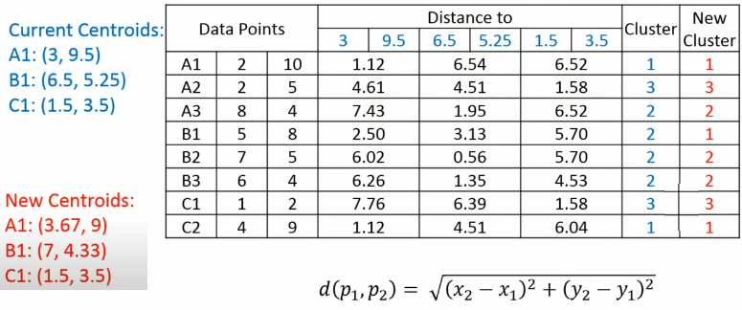

Slide 12
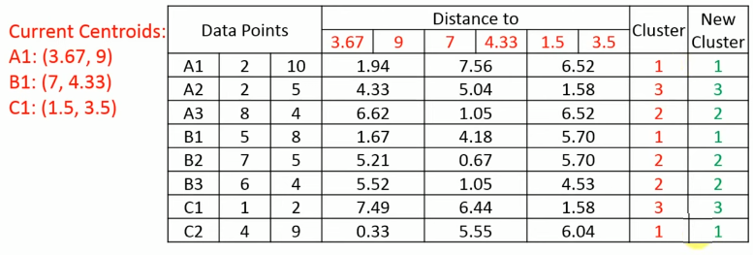
Final clusters are: {A1,B1,C2}, {A3,B2,B3} and {A2,C1}

Slide 13
Hierarchical Clustering
Hierarchical clustering is a technique that builds a hierarchy of clusters for a dataset. Unlike flat clustering methods like K-Means, hierarchical clustering organizes data into a tree-like structure called a dendrogram, which illustrates how clusters are merged (or split) at different levels.
Types of Hierarchical Clustering
1. Agglomerative Clustering
Bottom-Up Approach: Each data point starts as its own cluster, and clusters are iteratively merged based on similarity until a single cluster (or a specified number of clusters) remains.
Steps:
Start with each data point as an individual cluster.
Compute the distance (similarity) between all pairs of clusters using a distance metric (Euclidean distance).
Merge the two closest clusters into a single cluster.
Repeat steps 2 and 3 until all points are in a single cluster or the desired number of clusters is achieved.

Slide 14
Distance Metrics for Clustering
Single Linkage: Measures the shortest distance between any two points in different clusters.
Complete Linkage: Considers the farthest distance between points in different clusters; ensures compact and spherical clusters.
Average Linkage: Calculates the mean of all pairwise distances between points in two clusters; balances between Single and Complete Linkage.
Centroid Linkage: Uses the Euclidean distance between the centroids (average positions) of two clusters; focuses on cluster centers rather than individual points.

Slide 15
2. Divisive Clustering
Top-Down Approach: Start with all data points in one cluster and recursively split clusters into smaller clusters until each data point forms its own cluster (or a desired number of clusters is reached).
Steps:
Begin with all data points in a single cluster.
Identify the cluster to split using a criterion (e.g., largest variance or dissimilarity).
Divide the selected cluster into two sub-clusters based on a distance metric or other criteria.
Repeat step 2 and 3 until all points are in their own cluster or the desired number of clusters is achieved.
Challenges:
More computationally intensive than agglomerative clustering since splitting decisions require more global evaluations.

Slide 16
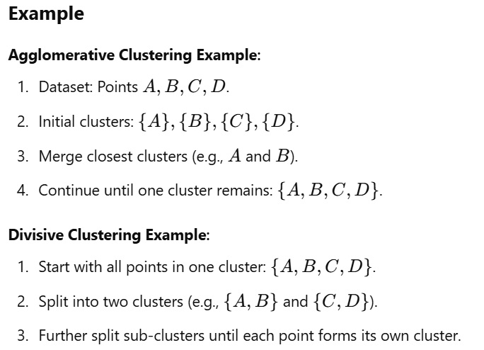

Slide 17
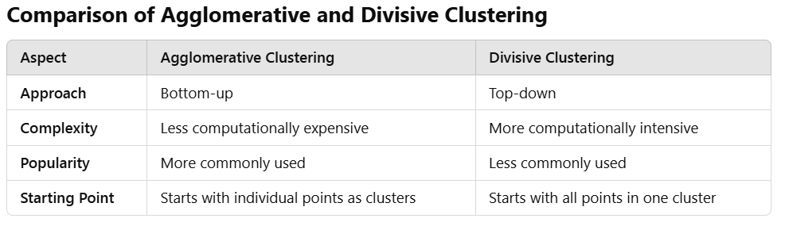

Slide 18
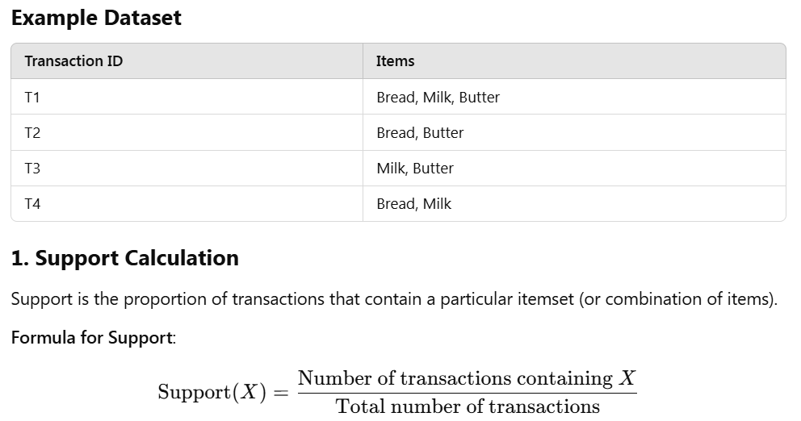
Frequent Pattern Mining
It is a data mining technique to discover patterns, correlations, or associations in datasets.
It identifies sets of items, sequences, or events that occur frequently together in transactional databases.

Slide 19
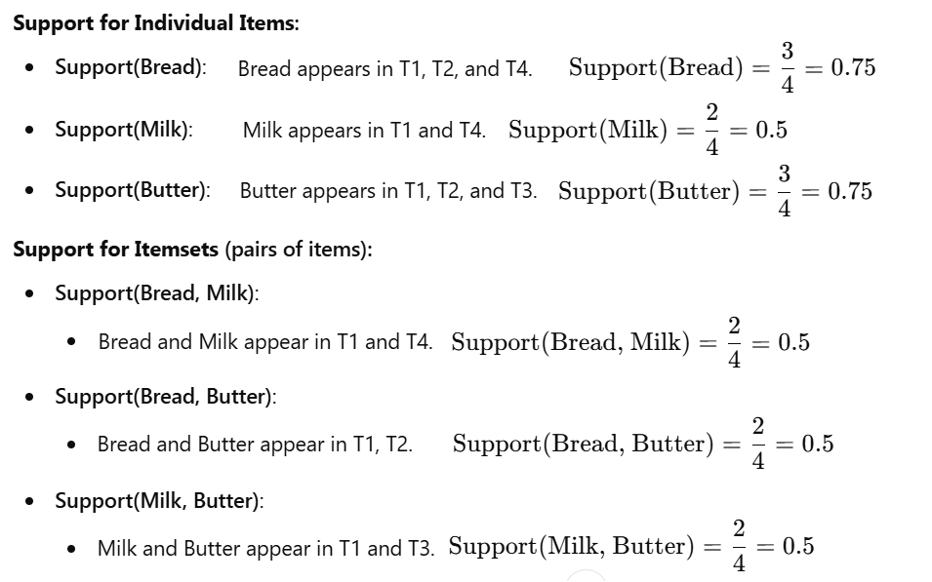

Slide 20
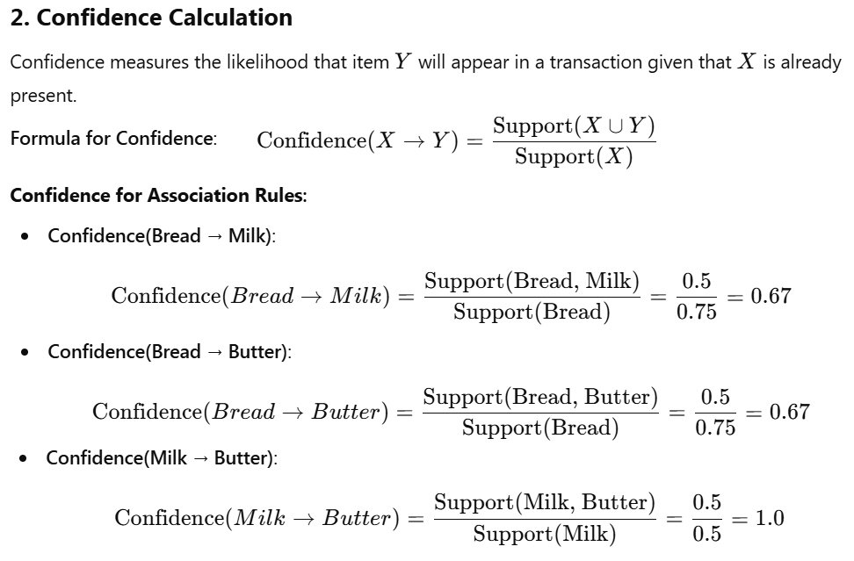

Slide 21
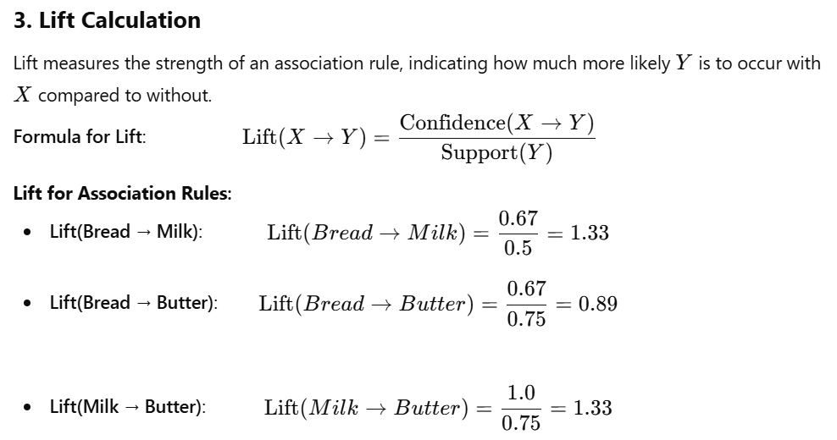

Slide 22
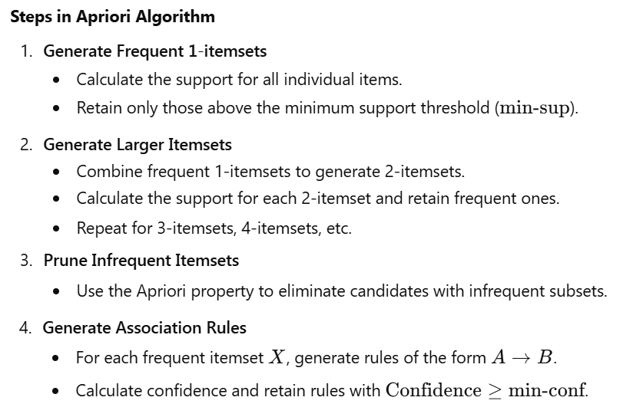
Apriori Algorithm
The Apriori Algorithm is an iterative method used to identify frequent itemsets in a dataset and generate association rules.

Slide 23
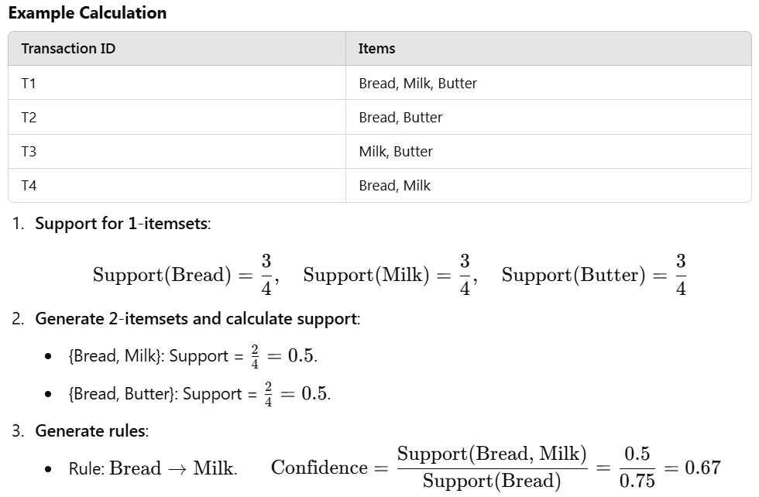

Slide 24
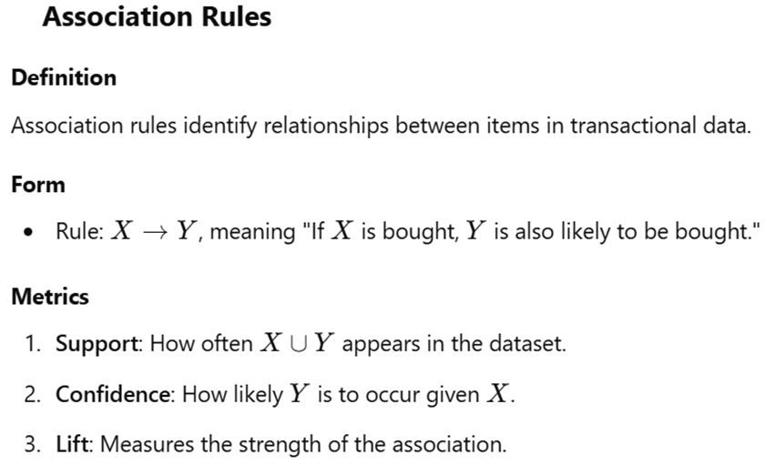

Slide 25
Graphical Models
Graphical models are probabilistic models that represent dependencies among variables using a graph structure. They are used for reasoning about uncertainty and for making predictions based on observed data.
Key Features:
Nodes: Represent random variables.
Edges: Represent probabilistic dependencies.
Types: Directed and undirected graphs.
Types of Graphical Models:
Bayesian Networks (Directed Acyclic Graphs): Captures conditional dependencies via directed edges.
Markov Networks (Undirected Graphs): Captures undirected dependencies.

Slide 26
What is a Bayesian Network?
A Bayesian network, also known as a Bayes network, belief network, or probabilistic directed acyclic graphical model.
It is a graphical model that represents a set of variables and their conditional dependencies via a directed acyclic graph (DAG).
Each node in the DAG corresponds to a random variable, and the edges represent direct causal or influential relationships between the variables.

Slide 27
Why Do We Need Bayesian Networks?
Bayesian networks are valuable tools for various reasons:
Uncertainty Modeling: It allow us to model uncertain information and make probabilistic inferences.
Causal Reasoning: It can represent causal relationships between variables, enabling us to understand how changes in one variable affect others.
Decision Making: It can assist in making decisions under uncertainty by considering multiple factors and their probabilities.
Learning from Data: It can be learned from data, allowing us to discover hidden relationships and patterns.
Inference and Prediction: It enable us to make predictions about unobserved variables based on observed evidence

Slide 28
Key Components of a Bayesian Network:
Nodes: Represent random variables.
Edges: Represent direct dependencies between variables.
Conditional Probability Distributions (CPDs): Associated with each node, these specify the probability distribution of a node's value given the values of its parent nodes.
Formulas and Concepts:
Joint Probability Distribution: The joint probability distribution of all variables in a Bayesian network can be factorized as the product of the conditional probabilities of each variable given its parents: P(X1, X2, ..., Xn) = Π P(Xi | Parents(Xi))
Bayesian Inference: Bayes' theorem is used to update beliefs about a variable given new evidence:
P(A|B) = P(B|A) * P(A) / P(B)

Slide 29
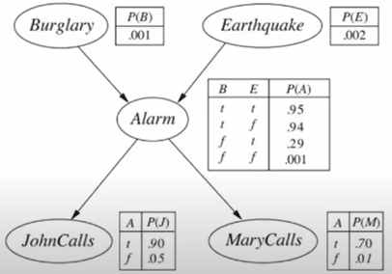
Example:
You have a new burglar alarm installed at home. It is fairly reliable at detecting burglary, but also sometimes responds to minor earthquakes. You have two neighbors, John and Merry, who promised to call you at work when they hear the alarm. John always calls when he hears the alarm, but sometimes confuses telephone ringing with the alarm and calls too. Merry likes loud music and sometimes misses the alarm. Given the evidence of who has or has not called, estimate the probability of a burglary.

Slide 30
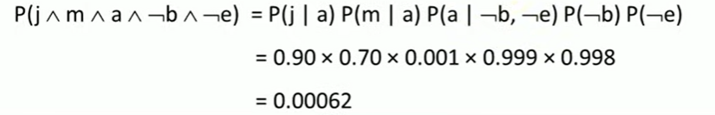
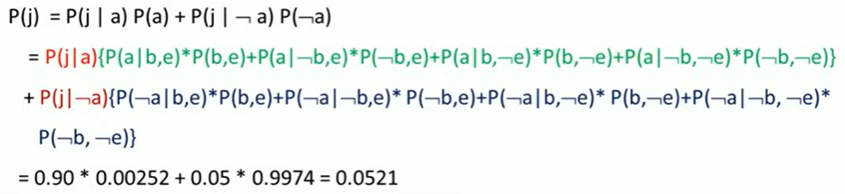
What is the probability that the alarm has sounded but neither a burglary nor an earthquake has occurred, and both John and Merry call?
What is the probability that john calls?

Slide 31
Markov Network
Its also known as a Markov Random Field (MRF).
It is a type of undirected graphical model that represents probabilistic relationships between random variables.
Markov Networks use undirected edges to represent pairwise relationships between variables.
Markov Network Parameters
Nodes: Represent random variables (e.g., "sunny," "rainy").
Edges: Represent pairwise relationships between variables (e.g., the influence of today's weather on tomorrow's).
Potential Functions: Measure the compatibility of joint assignments of values to variables within a clique (a fully connected subgraph). These functions quantify the strength of the relationship between variables.

Slide 32
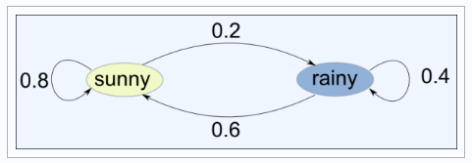

Markov Network Parameters
State Space:
The state space of a Markov Network is the set of all possible configurations of the variables. In the given example, the state space consists of two states: "sunny" and "rainy."
Initial Probability:
The initial probability distribution specifies the probability of each state at the initial time step. In the example: P(sunny) = 0.5 P(rainy) = 0.5
Transition Matrix:
The transition matrix defines the probabilities of transitioning from one state to another. In the example, the transition matrix would be:

Slide 33
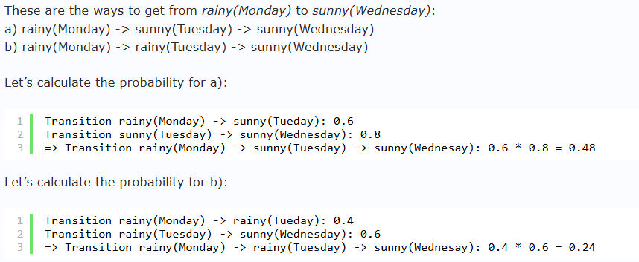

Slide 34
What are HMMs?
Hidden Markov Models (HMMs) are statistical models used to represent systems that are assumed to be Markov processes with unobserved (hidden) states.
HMMs are widely utilized in various fields, including speech recognition, bioinformatics, and finance.
Why are HMMs Needed
Modeling Sequential Data: They can effectively capture temporal dependencies in sequences.
Dealing with Uncertainty: HMMs provide a framework for modeling systems with hidden states and observations that can be noisy or incomplete.
Probabilistic Inference: They allow for the computation of probabilities of sequences of observations, making them suitable for tasks such as classification and prediction.

Slide 35
Parameters of HMM
States (S): A set of hidden states in the model. Each state represents a possible condition of the system.
Observations (O): A set of possible observations that can be generated by the states.
Transition Probabilities (A): A matrix where A[i][j] represents the probability of transitioning from state i to state j.
Emission Probabilities (B): A matrix where B[i][k] represents the probability of emitting observation k from state i.
Initial State Distribution (π): A vector where π[i] indicates the initial probability of being in state i.

Slide 36
Properties of HMM
Markov Property: The future state depends only on the current state and not on the previous states.
Stationary Transition Probabilities: The transition probabilities remain the same over time.
Memoryless: The model does not retain memory of past states beyond the current one.
States, Transitions, and Observations
States: These are not directly observable and represent the underlying processes.
Transitions: These define how likely it is to move from one state to another.
Observations: These are the outputs we can observe and are dependent on the states.

Slide 37
Forward Algorithm
The Forward Algorithm is used to calculate the probability of observing a sequence of events (observations) given a Hidden Markov Model.
Forward Algorithm Steps
Initialization: Compute the initial probabilities of the first observation.
Recursion: For each subsequent observation, update the probabilities based on the previous state probabilities and the transition/emission probabilities.
Termination: Sum the probabilities of ending in any state after the last observation.

Slide 38
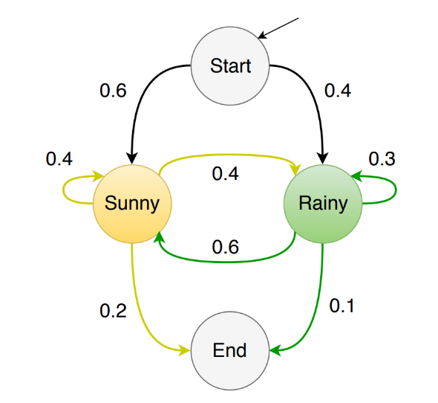
States: Start, Sunny, Rainy, End
Transition Probabilities:
Start to Sunny: 0.6
Start to Rainy: 0.4
Sunny to Sunny: 0.4
Sunny to Rainy: 0.6
Rainy to Sunny: 0.2
Rainy to Rainy: 0.3
Rainy to End: 0.1
Sunny to End: 0.2
Emission Probabilities (for illustration):
Assume:
P(Play | Sunny) = 0.7
P(Play | Rainy) = 0.4
P(Shop | Sunny) = 0.2
P(Shop | Rainy) = 0.5

Slide 39
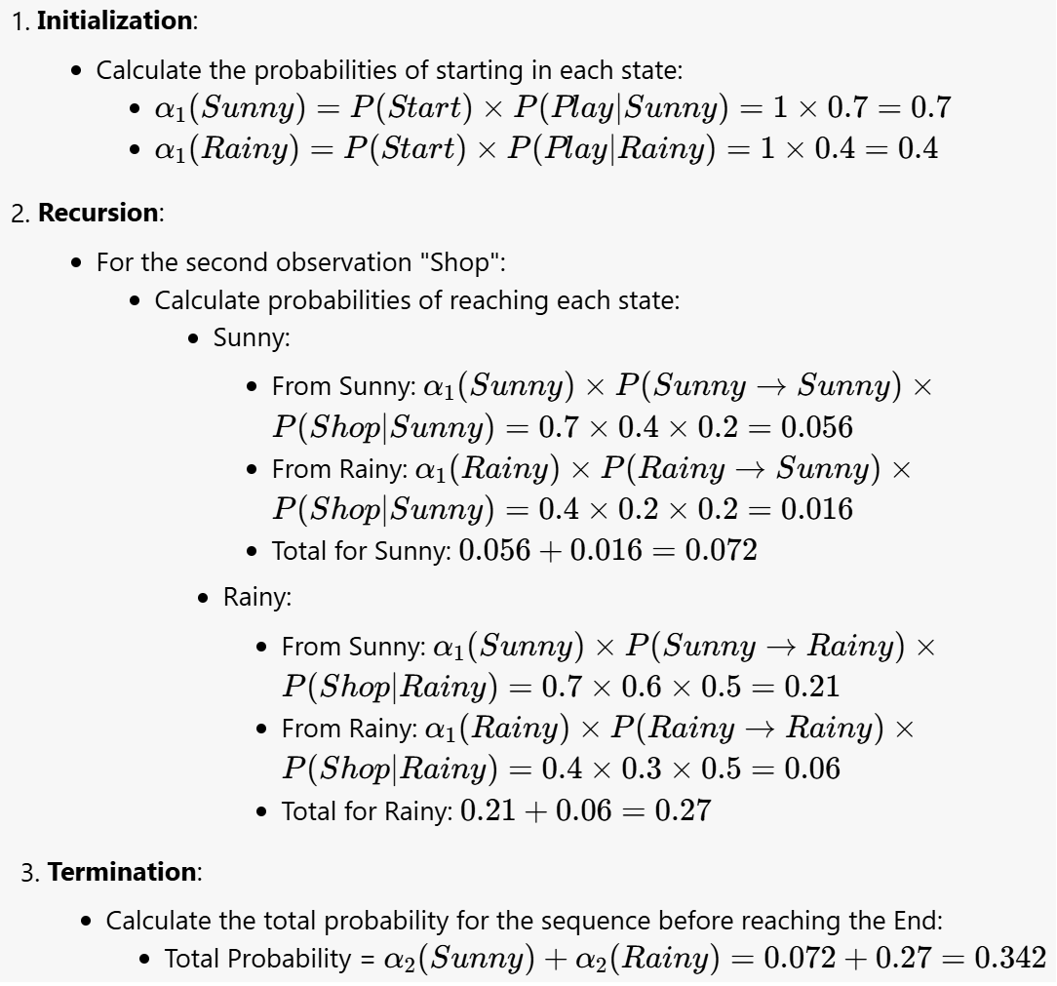

Slide 40
Viterbi Algorithm
The Viterbi Algorithm finds the most likely sequence of hidden states given the observed sequence. It uses dynamic programming similar to the Forward Algorithm but tracks the best paths taken to reach each state.
Viterbi Algorithm Steps
Initialization: Similar to the Forward Algorithm but also record the state paths.
Recursion: Update the probabilities and the paths for each observation.
Termination: Trace back the most likely path from the last state to the first.

Slide 41
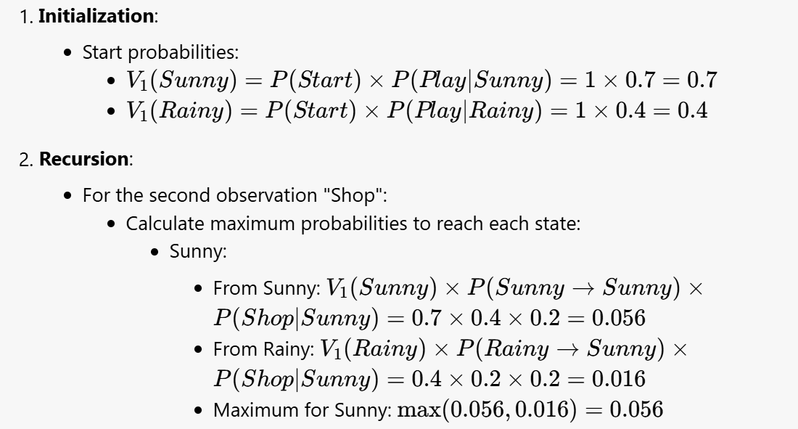

Slide 42
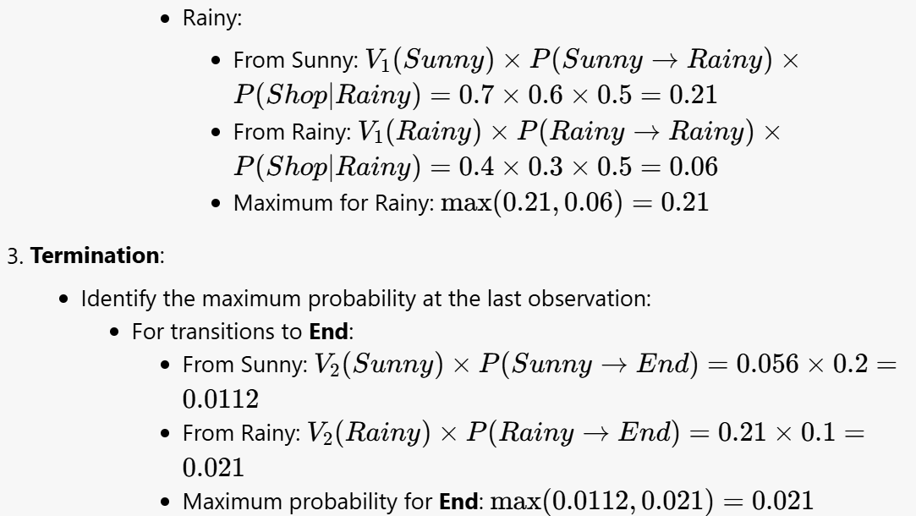
The path from Sunny → Rainy → Shop → End yields a maximum probability of 0.021.
The path from Rainy → Rainy → Shop → End yields a lower probability of 0.006.
The better path, based on the maximum probability of reaching the End state after observing the sequence,
is Sunny → Rainy.

